Slide 1
Moving Forward Session
Clare Weber
Academic Affairs
Muriel C. Lopez-Wagner
Institutional Research
May 10, 2018
GI2025 Collaboration, Coherence, and Commitment

Slide 2
What is our ultimate goal?
The capacity of an institution in helping students.
Levels of achievement of a student or group of students.
Affordability (according to state and federal policy makers).
Usual definitions: persistence, retention, graduation, content knowledge, literacy, and engagement
Decisions made to intentionally decrease equity gaps.
Increase Student Success
From Kinzie & Kuh, Reframing Student Success in College, Change, 2017

Slide 3
Why the low graduation rate…still?
Too many approaches. Too many disparate and disconnected programs.
Solutions were created before we knew the problem or its context.
From Kinzie & Kuh, Reframing Student Success in College, Change, 2017

Slide 4
Drivers of Student Success
From Kinzie & Kuh, Reframing Student Success in College, Change, 2017
Increase Student Success
Comprehensive, integrated approach
Empirically based approaches
Clear pathways learning & success
Enact the mindset
Cultural system
Evidence of quality, assessment data, greater integration of curriculum and co
Implementation of empirically based approaches, effective orientation and experiences
Strategic relationships with P-12, community, families, universities, asset based narrative
Maps to transitions, clear whole programs, roadmaps
Encourage and belief, growth mindset
How?
How?
How?
How?
How?

Slide 5
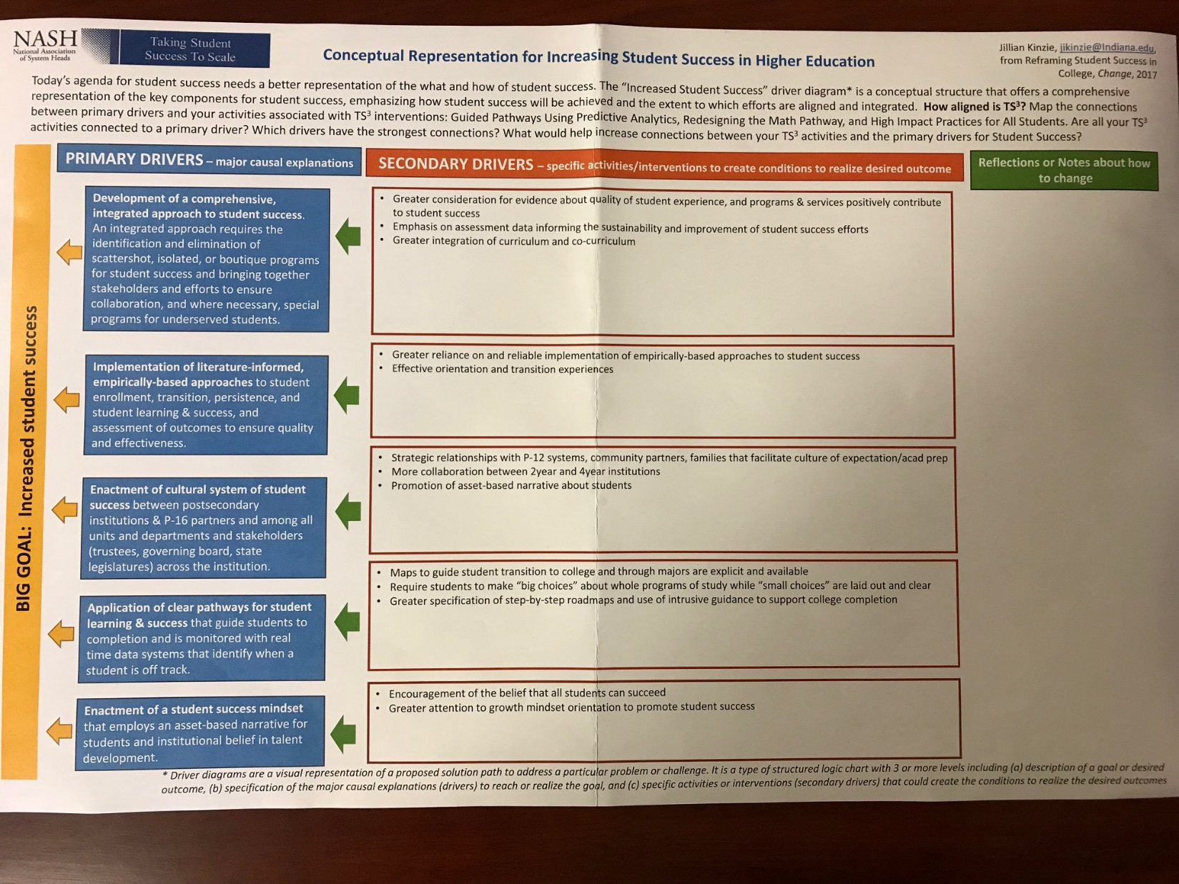

Slide 6
Where do you fit in?
Review the five Secondary Drivers for Increasing Student Success in Higher Education
Determine which Secondary Drivers you are actively working on
Write your name and program(s) on the sticky notes that you’ve been given and attach them to the easels that match the secondary drivers you are working on

