Slide 1
Career & Major Exploration
SPRING 2020: Career Readiness Workshop Series

Slide 2
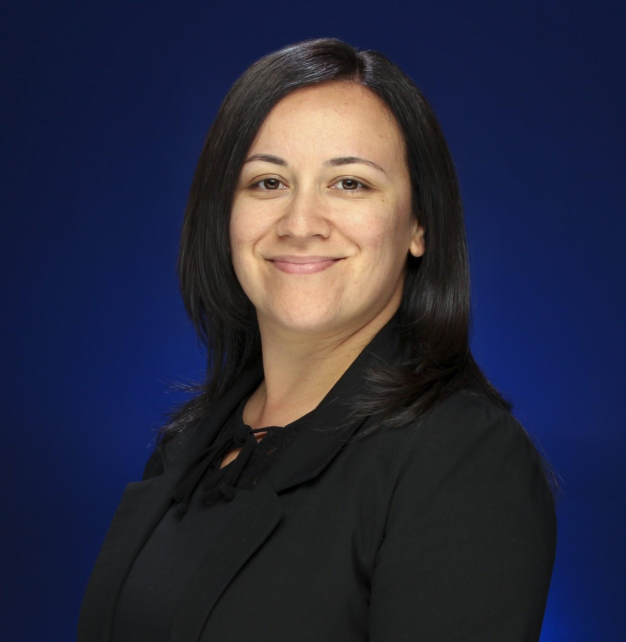
Presented by
Denise Perez-Flores, Career Counselor
Career Center, Division of Student Affairs
Email: denise.perezflores@csusb.edu
Phone: 909-537-3256

Slide 3
Workshop Overview
Career & Major Exploration
Not sure what direction to take with your degree or sure what degree you want to pursue? In this workshop you will learn how to:
Utilize online resources to explore career and major pathways
Develop a plan for after (post) graduation
Identify ways to gain experience that will expose you to your career interests

Slide 4
Major Exploration

Slide 5
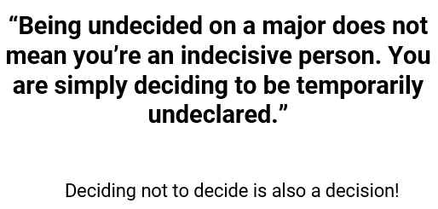

Slide 6
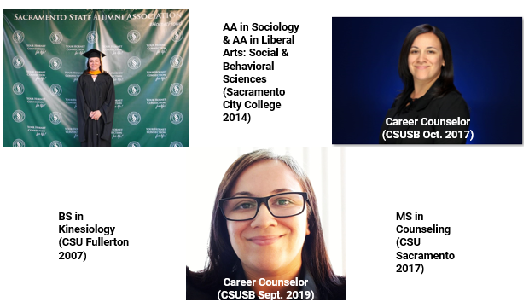
17 Years in the Making

Slide 7
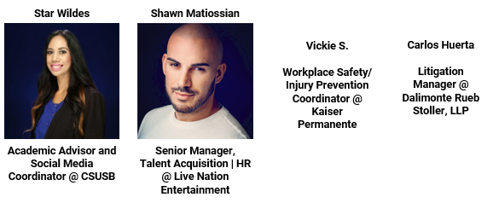
We all have to start somewhere!
Can you guess what their majors were?

Slide 8
We all have to start somewhere!

Slide 9
Activity: Where are you now?
Take out a piece of paper and answer the following questions:
What is your current class standing (freshman, sophomore, junior, senior)?
If you have a current major, what is it?
If you are undeclared, what major are you interested in?
If you are currently wanting to change your major, what major are you interested in changing it to?

Slide 10
Activity:
What majors does CSUSB offer and
what are your top choices?
Step 1:
-Let’s review the CSUSB Majors Worksheet! http://tiny.cc/CSUSBMajors
Step 2:
-Choose your top 3 majors
Step 3:
-Use this website http://tiny.cc/CSUSBProg
-To review courses in each major and on the same sheet of paper write down what you like most about each major

Slide 11
Other Ways to Explore Majors
Take courses in major(s) of interest to gain an in-depth understanding of the subject matter.
Join an on-campus student club or organization.
Conduct an informational interview with someone who graduated with your major(s) of interest.

Slide 12
Other Ways to Explore Majors
Take an inventory or assessment such as the Strong Interest Inventory or Myers-Briggs Personality Type Indicator using Humanmetrics.com, 16personalities.com, or CA CareerZone. You can also meet with a Career Counselor to take the formal versions.
Meet with a Peer Advisor, Academic Advisor/Counselor, or Faculty Advisor in the department of your intended or declared major.
General Academic Advisor (for undeclared students).

Slide 13
Career Exploration

Slide 14
Activity:
10 Clues to Career Direction
http://tiny.cc/10clues
Handout Questions :
What do I love to do? What would I do even if I were not paid to do it?
What parts of my life do I thoroughly enjoy? When am I energized?
What do I naturally do well?
What classes fascinate and absorb me?
Is there a cause I am passionate about? What about the cause am I attracted to?
What messages am I receiving from family/peers about my career direction? Which ones fit for me? Which ones don’t?

Slide 15
Activity:
10 Clues to Career Direction
http://tiny.cc/10clues
Handout Questions :
Who are my heroes and heroines? What traits do I admire about them?
What do I most often want to talk or read about?
If I were writing my epitaph, what would I want to be remembered for? (Epitaph: a phrase or form of words written in memory of someone)
What would I do if I knew I could not fail? (Look beyond any perceived limitations)

Slide 16
Ways to Explore Careers
Utilize Resources
What Can I Do With This Major?
ONet Online
U.S. Bureau of Labor Statistics

Slide 17
Ways to Explore Careers
Connect with Others and Get Experience
Connect with CSUSB Alumni through the Alumni Mentor Program or LinkedIn.
Gain experience through volunteer, internship, and job opportunities.
Attend a Career Center workshop, fair/expo/speaker panel, or employer information/tabling session.

Slide 18
Career Counseling
Appointments (30 mins.)
SPRING 2020: ONLINE AND PHONE ONLY
Counselors help with:
Major & career exploration
Career & educational planning
Resumes, cover letters, & CV’s
Job & internship search
Networking
Graduate school preparation
LinkedIn profile building
Interview skills & practice
Salary negotiation
www.csusb.edu/career-center/students-alumni/meet-career-counselor

Slide 19
Spring 2020: Drop-ins Cancelled

Slide 20
Free Professional Clothing
How it works:
All attire is Free to students and alumni
Stop by Mon. - Fri. from 8am - 5pm
Sign in with your student ID# at the front desk
After you find what you need, bring items to the front desk for checkout
Inventory arrives on a regular basis
Consider building your professional wardrobe before it is needed

Slide 21
Spring 2020 Events

Slide 22
If you would like to provide feedback on the workshop please complete the brief online survey by using this link:
https://bit.ly/395k788
Your feedback is greatly appreciated!

Slide 23
Career Center Information
Main Campus
University Hall 329
Phone: 909-537-5250
Email: careercenter@csusb.edu
Website: www.csusb.edu/career-center
Palm Desert Campus
Indian Wells 111
Phone: 909-537-8243
Email: pdccareercenter@csusb.edu
Website: https://pdc.csusb.edu/current-students/career-service
Notes:
Palm Desert Campus
Hours: 8:00 am - 5:00 pm
Location: IW-111
Phone: (909) 537-8243
Email: pdccareercenter@csusb.edu

